Slide 1
Ration Balancing
Team - Ignite
Lakshmi Seshu Kalvakuri
Hyndavi Musipatla
Sai Varun Anugu
Karthik Reddy Bijjam
Satyavrath Injamuri
Sanjana Tummala

Slide 2



Team Members
Karthik Reddy Bijjam
Satyavrath Injamuri
Sai Varun Anugu

Slide 3


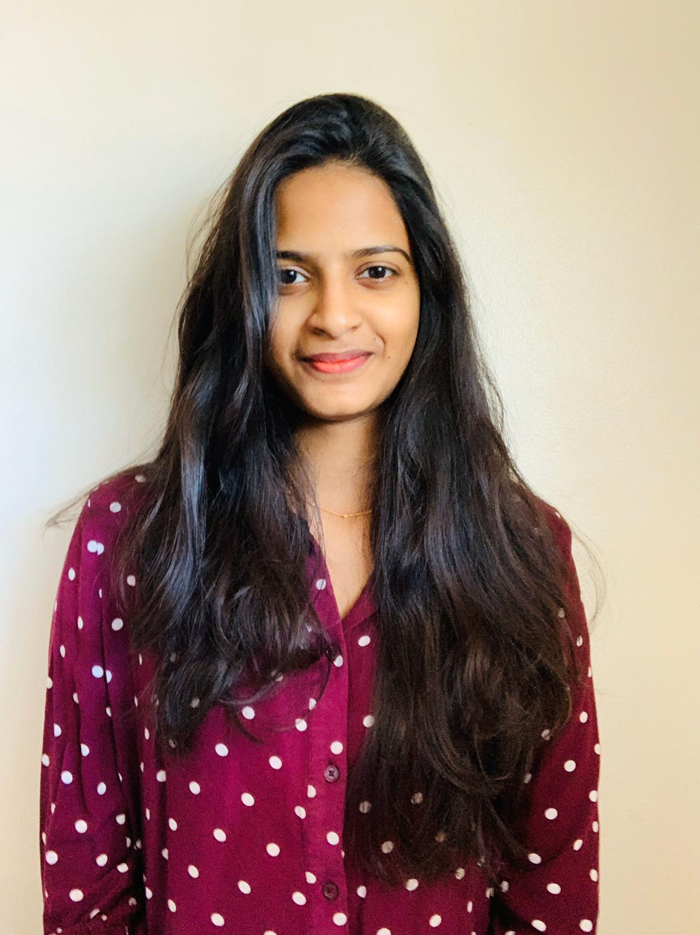
Team Members
Sanjana Tummala
Hyndavi Musipatla
Lakshmi Seshu Kalvakuri

Slide 4

CLIENT
DR. MARCUS MCGEE
Assistant Professor of Animal Science at Northwest Missouri State University.
Published research papers on Muscle and Adipose Tissue: Potential Roles in Driving Variation in Feed Efficiency.

Slide 5
Content
Project Purpose
User Requirements
Project Description
Tools/Technology
Demo
Login
Cattle weight
Feedstuff
Ration weight Page.
Logout
Conclusion

Slide 6
Project purpose
The purpose of the project is to create a web-based application which helps the end user to calculate the amount of ration needed for cattle by considering the inputs such as cattle weight, feed stuffs, and growth rate. It is used in calculating the amount of ingredients needed for the cattle.

Slide 7
User requirements
Select the weight of the cattle and growth rate.
Select the Ingredients, and must give input for cost, but optional
for quantity.
The Ration will be generated based on the cost and nutrients and the dry matter is calculated.

Slide 8
PROJECT DESCRIPTION
User should be able to login.
It is an online website to calculate the ration weights.
It allows user to select the cattle weights and the growth rate.
Allows user to edit the Minimum and Maximum values of the Nutrients.
It allows user to select the Ingredients and enter the cost and quantity.
Cost is Mandatory whereas quantity is an optional.
If user doesn’t enter the quantity the program calculates.
The user can delete the ingredients if needed.

Slide 9
PROJECT DESCRIPTION (Cont..)
The user can go back and change the values if needed.
The total ration weight and the dry matter ration weight is calculated.
The ration weights which are less than the minimum are displayed red in color.
The ration weights which are more than the maximum are displayed blue in color.
The user can go back and change the quantity or the feedstuff if needed.

Slide 10
Tools/Technology
TECHNOLOGIES
HTML
CSS
JAVASCRIPT
NODE
EXPRESS FRAMEWORK
TOOLS
VISUAL STUDIO CODE
GITHUB

Slide 11
Demo
Deployed Link:
http://rationbalancing.herokuapp.com/
GitHub Link:
https://github.com/Satyavrath/rationbalancing

Slide 12
conclusion
Defined the project purpose accurately.
Successfully gathered user requirements from the client.
Developed computer-based prototype successfully.
Developed web application successfully.
Calculated the ration weights based on cost successfully.

Slide 13


Any questions ?

Slide 14
Thank you ☺

